Slide 1
Storing & Indexing Elements
Brief overview of the concepts
Binary Search Tree (BST)
Hashing
Perfect Hashing
Universal Hashing
Open Hashing
Neighbourhood Numbers are Hashed in Neighbourhood only? (Yes/No)
Rehashing
Concurrent hash table
Cuckoo hashing

Slide 2
Binary Search Tree

Slide 3
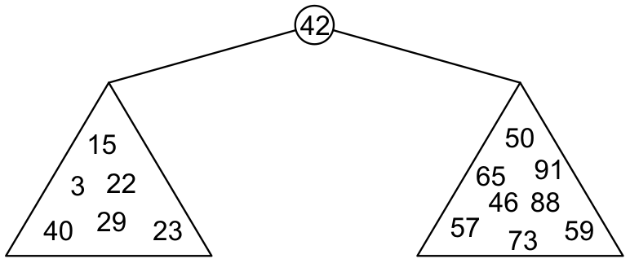
Binary Search Trees
Graphically, we may show the relationship as
Each of the two sub-trees will themselves be binary search trees

Slide 4
Definition
Thus, we define a non-empty binary search tree as a binary tree with the following properties:
The left sub-tree (if any) is a binary search tree and all elements are less than the root element, and
The right sub-tree (if any) is a binary search tree and all elements are greater than the root element

Slide 5
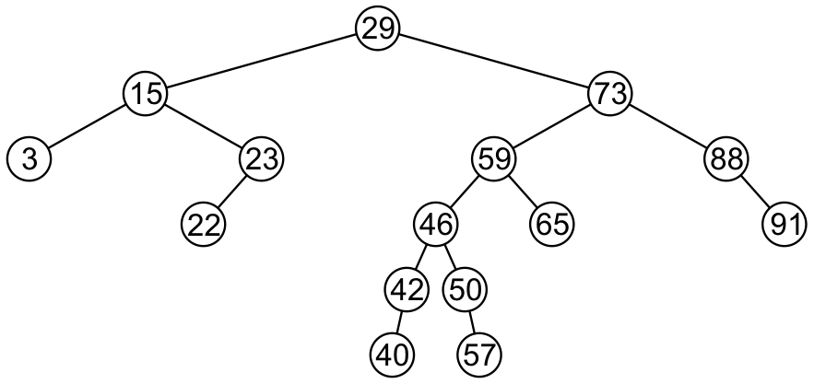
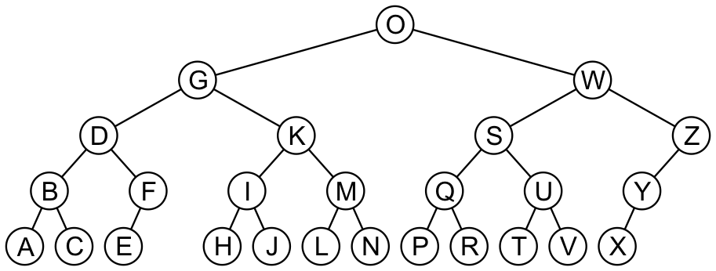
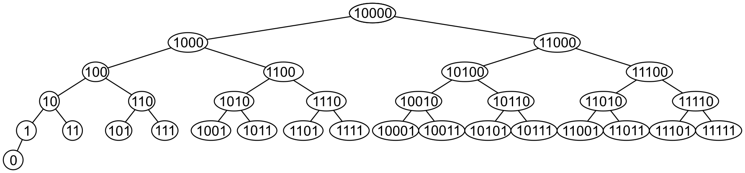
Examples
Here are other examples of binary search trees:

Slide 6
46 | 23 | 40 | 65 | 15 | 88 | 57 | 3 | 50 | 91 | 73 | 59 | 22 | 29 | 42
29 | 73 | 88 | 15 | 23 | 22 | 59 | 3 | 91 | 46 | 50 | 42 | 40 | 57 | 65
3 | 15 | 22 | 23 | 29 | 40 | 42 | 46 | 50 | 57 | 59 | 65 | 73 | 88 | 91
3 | 50 | 46 | 29 | 40 | 65 | 15 | 42 | 57 | 22 | 23 | 59 | 73 | 91 | 88

Slide 7
46 | 23 | 40 | 65 | 15 | 88 | 57 | 3 | 50 | 91 | 73 | 59 | 22 | 29 | 42
29 | 73 | 88 | 15 | 23 | 22 | 59 | 3 | 91 | 46 | 50 | 42 | 40 | 57 | 65
3 | 15 | 22 | 23 | 29 | 40 | 42 | 46 | 50 | 57 | 59 | 65 | 73 | 88 | 91
3 | 50 | 46 | 29 | 40 | 65 | 15 | 42 | 57 | 22 | 23 | 59 | 73 | 91 | 88

Slide 8
46 | 23 | 40 | 65 | 15 | 88 | 57 | 3 | 50 | 91 | 73 | 59 | 22 | 29 | 42
29 | 73 | 88 | 15 | 23 | 22 | 59 | 3 | 91 | 46 | 50 | 42 | 40 | 57 | 65
3 | 15 | 22 | 23 | 29 | 40 | 42 | 46 | 50 | 57 | 59 | 65 | 73 | 88 | 91
3 | 50 | 46 | 29 | 40 | 65 | 15 | 42 | 57 | 22 | 23 | 59 | 73 | 91 | 88

Slide 9
46 | 23 | 40 | 65 | 15 | 88 | 57 | 3 | 50 | 91 | 73 | 59 | 22 | 29 | 42
29 | 73 | 88 | 15 | 23 | 22 | 59 | 3 | 91 | 46 | 50 | 42 | 40 | 57 | 65
3 | 15 | 22 | 23 | 29 | 40 | 42 | 46 | 50 | 57 | 59 | 65 | 73 | 88 | 91
3 | 50 | 46 | 29 | 40 | 65 | 15 | 42 | 57 | 22 | 23 | 59 | 73 | 91 | 88

Slide 10
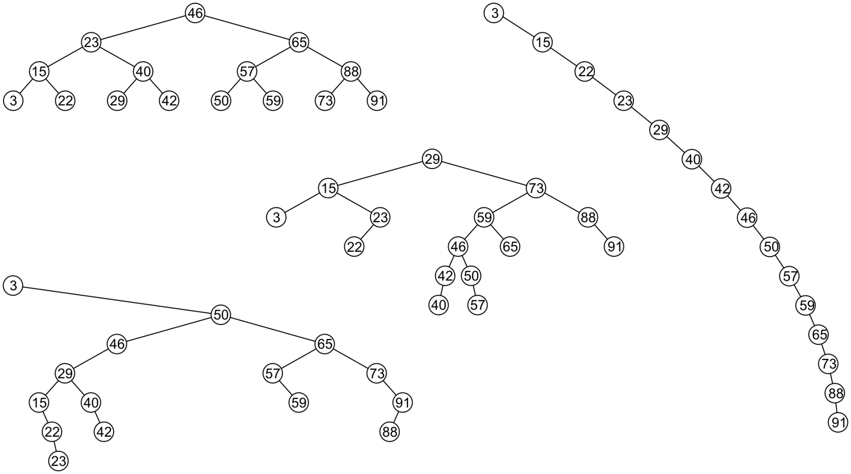
Examples
All these binary search trees store the same data

Slide 11
Duplicate Elements
We will assume that in any binary tree, we are not storing duplicate elements unless otherwise stated
In reality, it is seldom the case where duplicate elements are stored as separate entities

Slide 12
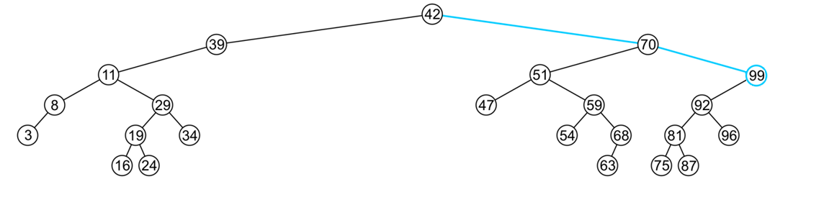
Finding the Max/Min Object
The run time O(h)
The extreme values (max/min) are not necessarily leaf nodes
Notes:
12

Slide 13
Binary Search Approximation
What is Binary Search Approximation? (Approximate binary search)
Given a set of keys and a sorted (non-decreasing) vector of values, use a binary search to find the indexes in values that match the values of key. This implementation allows for returning the index of the nearest match if there are no exact matches. It also allows specifying a tolerance for comparison of doubles.
Approximation in Binary Search:
Consider the children's game "guess a number." The scorer has a secret number, and will only tell the player if their guessed number is higher than, lower than, or equal to the secret number. The player then uses this information to guess a new number. But the upper bound and lower bound is not known.

